Slide 1
Analyse Azure Cost in PowerBI for Microsoft Sponsorship subscriptions
Peter Perov,
Cloud Solutions Architect

Slide 2
Agenda
Introduction
Cost Management
Demo
QnA

Slide 3


Cost Management

Slide 4
Azure Subscriptions available to CSA
Microsoft managed
fdpo.microsoft.com non-prod tenant
Self managed
https://my.visualstudio.com/ for every FTE - $150 p/m
External tenant
Honourable mention
Microsoft 365 Developer Program – developer E5 licenses * 25, free
Notes:
Visual Studio
Simply login as your Microsoft.com email and choose “Visual Studio Enterprise (FTE)” benefit
Fdpo wiki page:
https://dev.azure.com/servicesdocs/DevOps/_wiki/wikis/AzureInWCB%20wiki/32155/Managed-Azure-Tenant-Environment

Slide 5
Options
Get started with Cost Management + Billing reporting
 | PAYG | MCA | Direct EA, CSP | Indirect EA
Azure Portal - Cost Analysis (*) | Yes | Yes | Yes
EA Portal |  |  |  | Yes
Power BI Connector |  | Yes | Yes
Cost Management API (**) |  | Yes | Yes
Microsoft.Consumption API (**) | Yes | Yes | Yes
(*) Both Cost Management and Cost Management (preview) are available at this time (Nov’22)
(**) multiple APIs available, some in preview, some being deprecated
Notes:
Get started with Cost Management + Billing reporting
https://learn.microsoft.com/en-us/azure/cost-management-billing/costs/reporting-get-started
Azure EA portal administration
https://learn.microsoft.com/en-us/azure/cost-management-billing/manage/ea-portal-administration
Migrate from Azure Enterprise Reporting to Microsoft Cost Management APIs overview
https://learn.microsoft.com/en-us/azure/cost-management-billing/automate/migrate-ea-reporting-arm-apis-overview
EA Portal
https://ea.azure.com
Billing accounts and scopes in the Azure portal
https://learn.microsoft.com/en-us/azure/cost-management-billing/manage/view-all-accounts
View your usage summary details and download reports for direct EA enrollments
https://learn.microsoft.com/en-us/azure/cost-management-billing/manage/direct-ea-azure-usage-charges-invoices

Slide 6
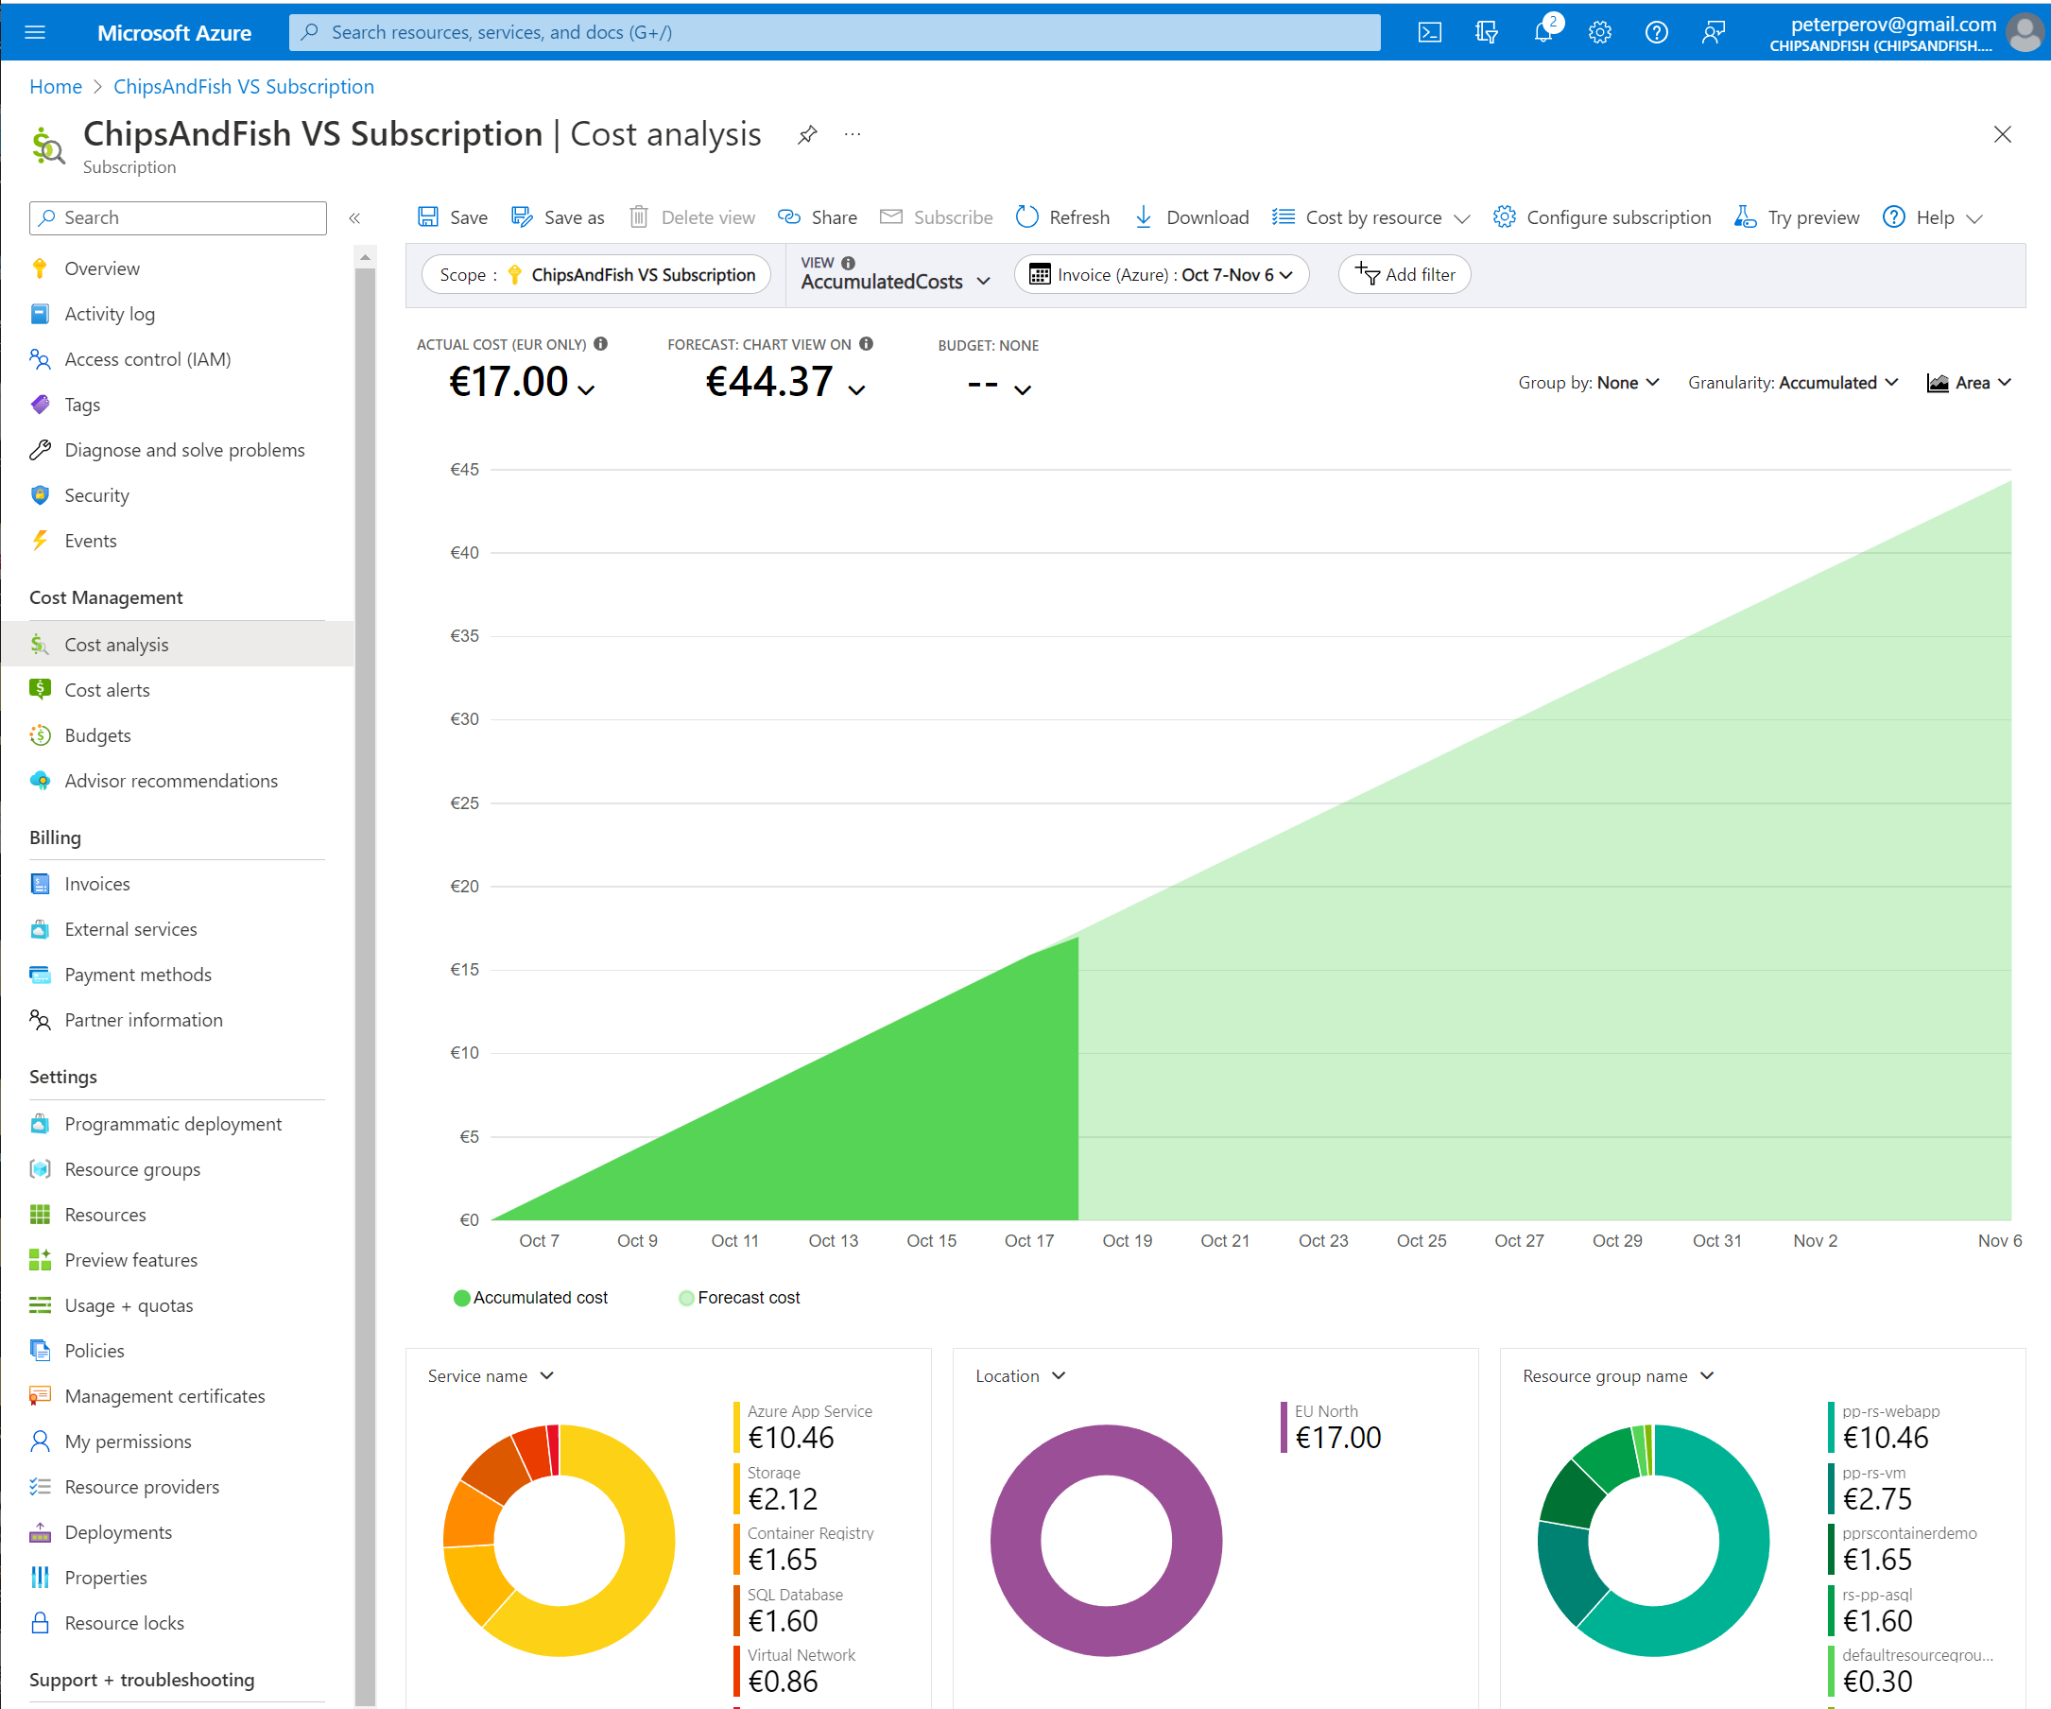
PAYG Customers Azure Portal - Cost Analysis

Slide 7
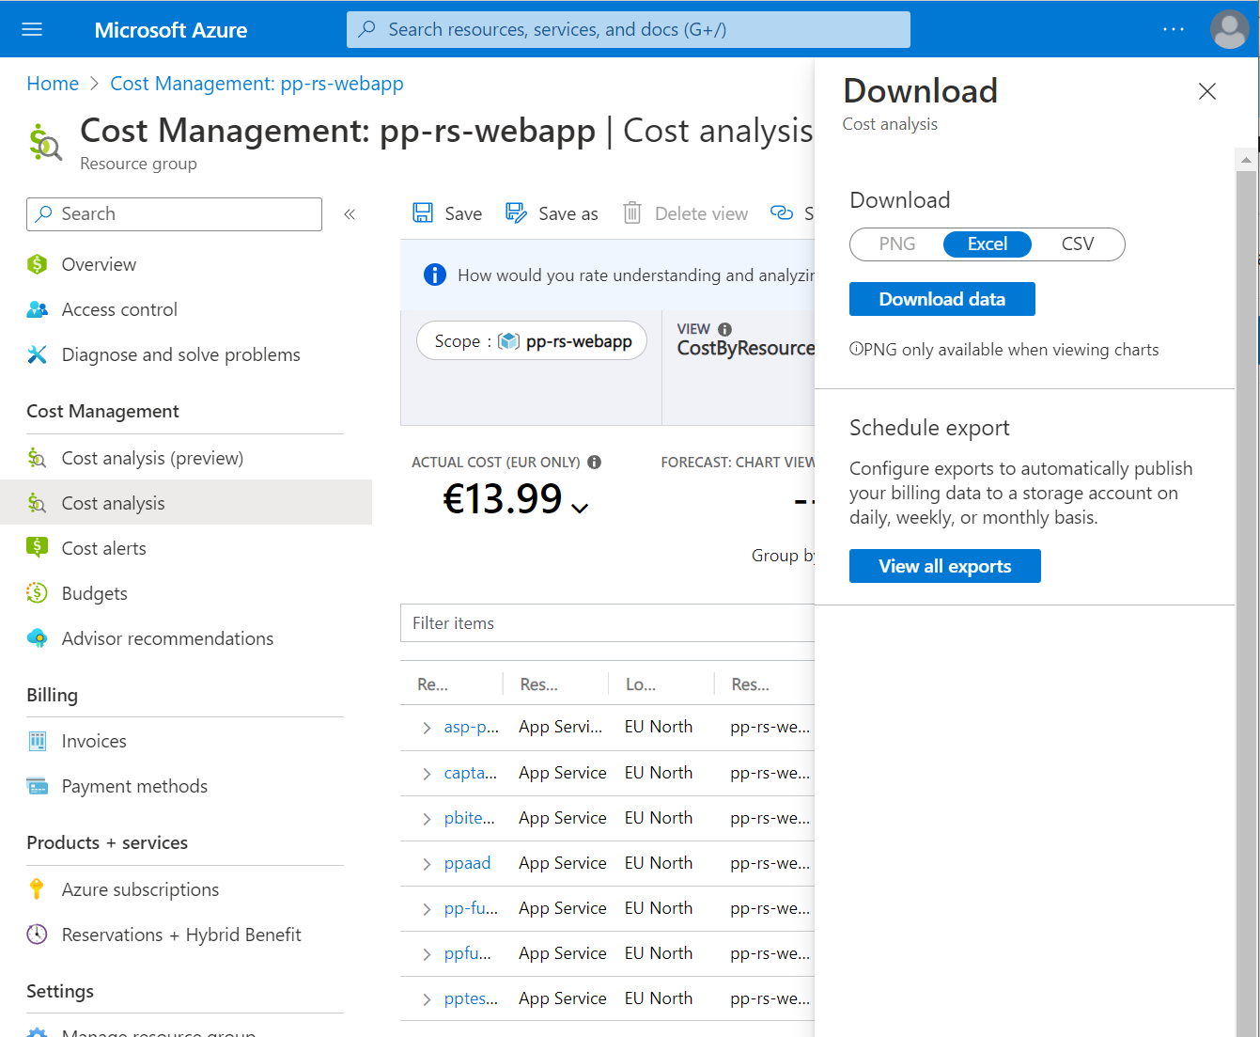
Scheduled Export
Portal -> Cost Analysis
View -> CostByResource
Download
Schedule Export
Configure Storage account
Register RP: Microsoft.CostManagementExports
Subscription
Resource Providers
Register
Create Container
Notes:
Consumption - Usage Details - List
https://docs.microsoft.com/en-us/rest/api/resources/providers/register

Slide 8
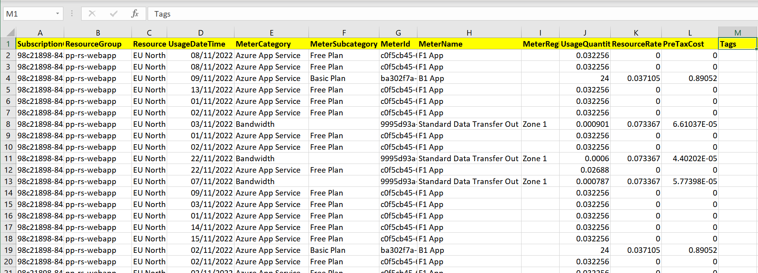
Exported .csv
ResourceGroup
Tags
UsageDateTime
MeterCategory, MeterSubcategory, MeterName
UsageQuantities, ResourceRate, PreTaxCost

Slide 9
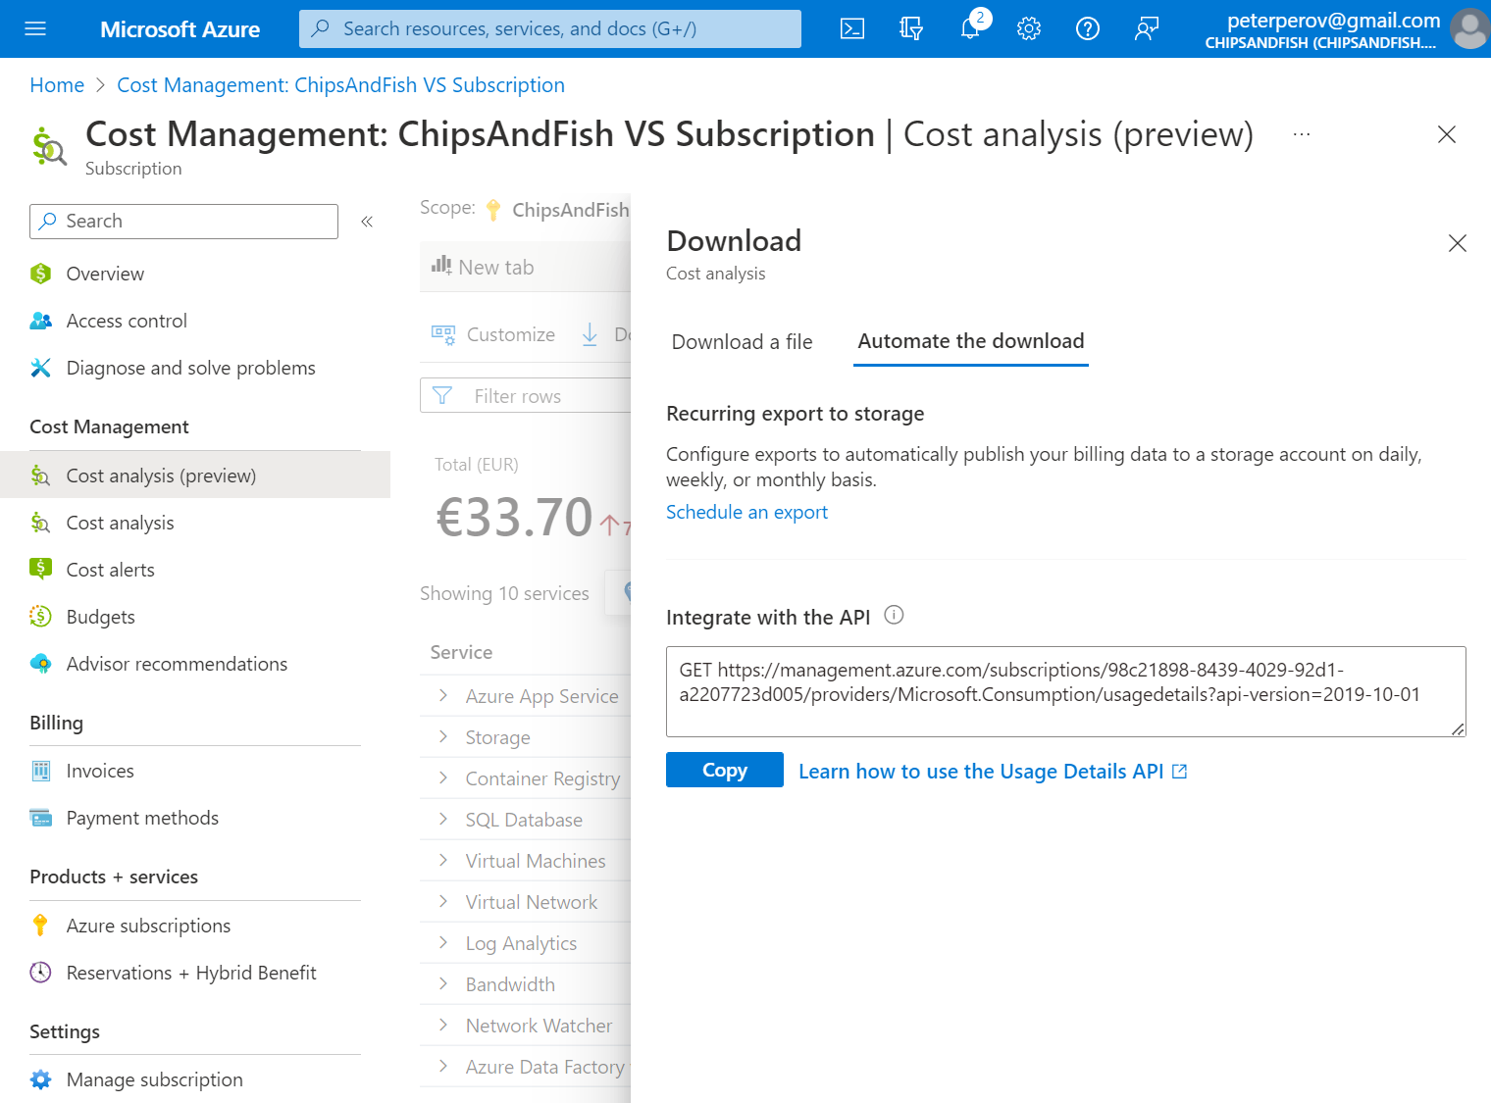
API Export (Preview, Nov’22)
Portal -> Cost Analysis (preview)
Services
Download
Automate the download
Notes:
Full guide on how to call the api: create Service Principal, assign billing scope, use the access token
Getting started with the Microsoft Azure Billing API’s
https://medium.com/@sambowenhughes/getting-started-with-the-microsoft-azure-billing-apis-aa27af11c1d0
Consumption - Usage Details - List
https://learn.microsoft.com/en-us/rest/api/consumption/usage-details/list?tabs=HTTP

Slide 10
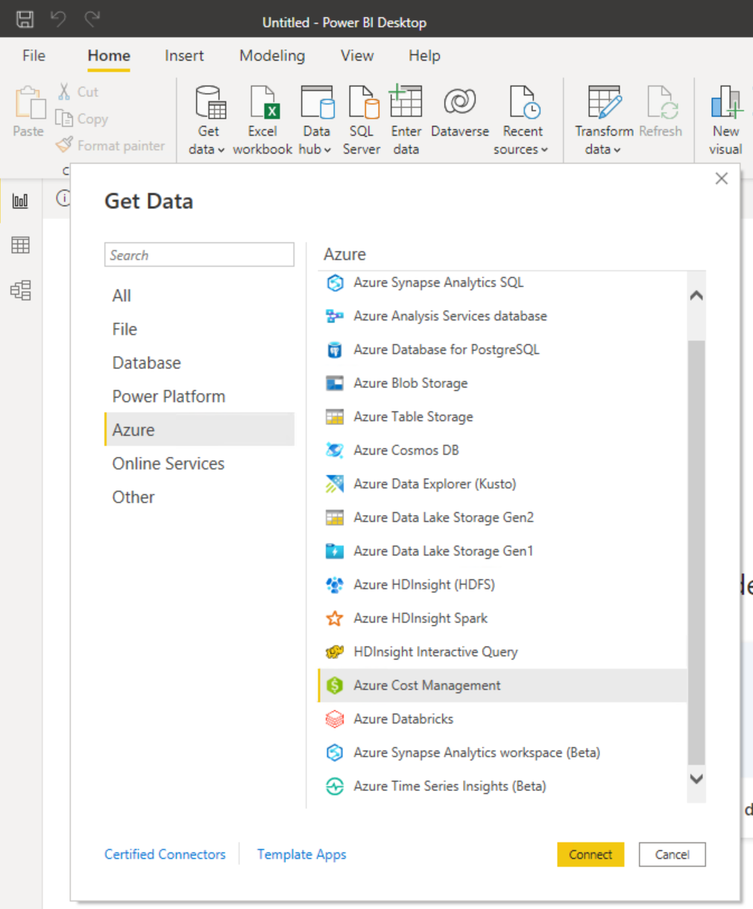
Power BI Cost Management Connector
Direct MCA
EA
Notes:
Create visuals and reports with the Azure Cost Management connector in Power BI Desktop
https://learn.microsoft.com/en-us/power-bi/connect-data/desktop-connect-azure-cost-management

Slide 11
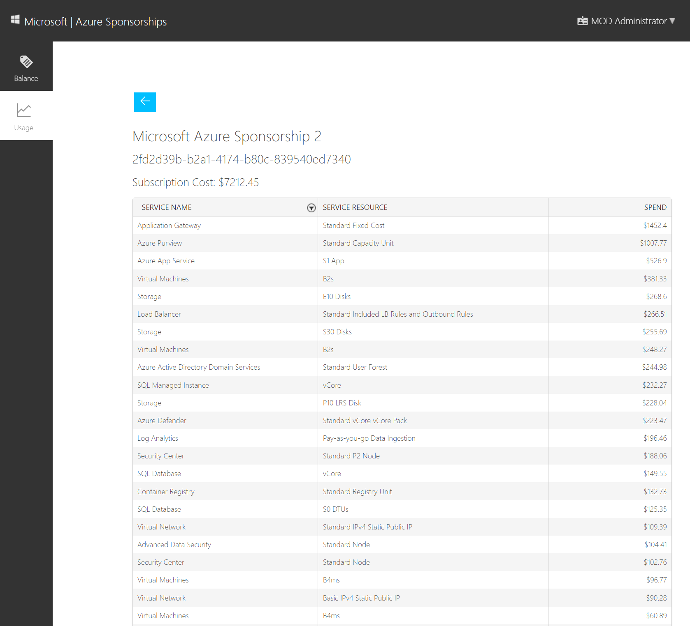
Azure Sponsorship https://microsoftazuresponsorships.com/
Notes:
Important to log in as a subscription owner

Slide 12
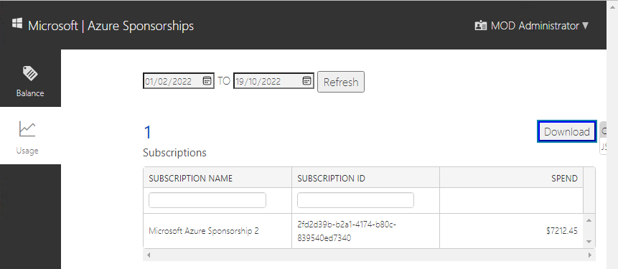
Download .csv
When you click Download, mind the hiding dropdown
Clicking on it will download .csv file with consumption report

Slide 13
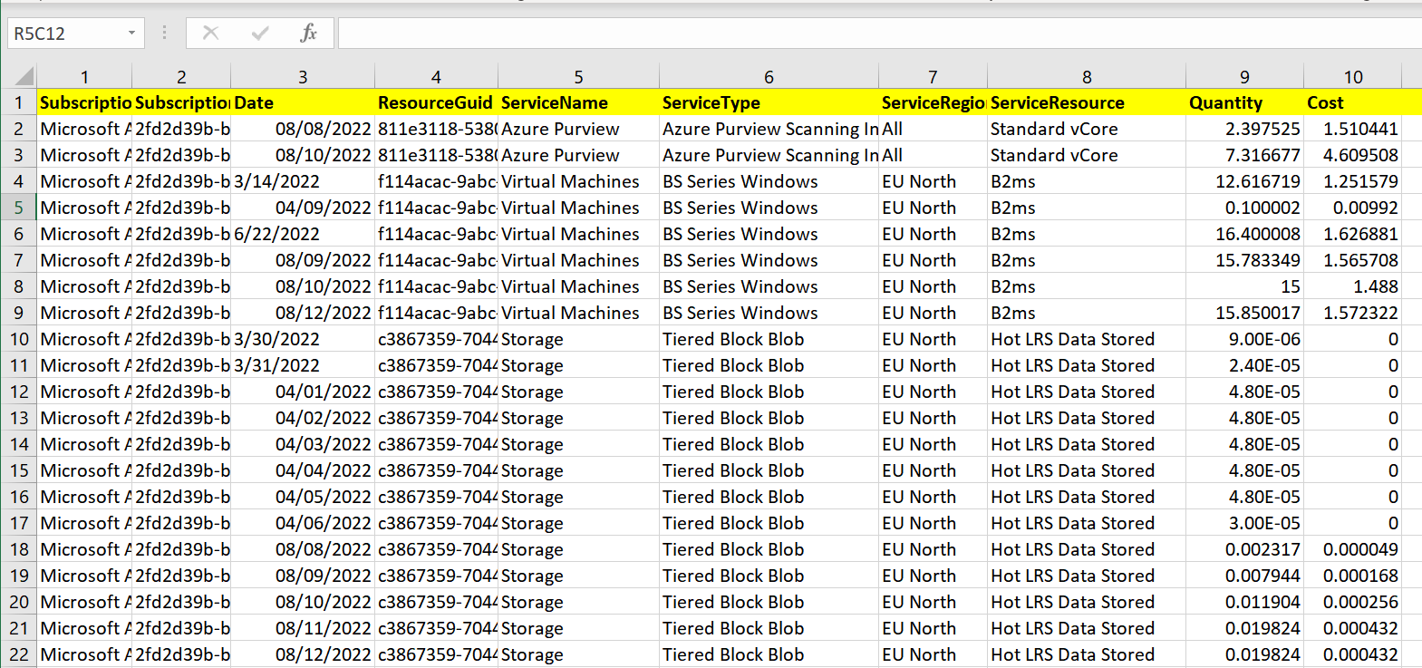
Sponsorship report .csv

Slide 14

Power BI

Slide 15
PowerBI Landscape
PowerBI Desktop - free
PowerBI Service – SaaS application, MW Land
PowerBI Embedded – compute resource on Azure
PowerBI Server – on-prem, usually SQL EE + SA

Slide 16
Demo

Slide 17
Files on GitHub
https://github.com/peterperov/MSFTCSA/tree/main/126-AzureCost

Slide 19
Thank you

Slide 21
What’s missing
.CSV only, no reporting
Dates in US format (mm/DD/yyyy)
Numbers in US format ( #,####.## )

Slide 22
Getting Latest file
Given: list of files AzureUsage (x).csv pick the latest as a source
Solution:
Get Data
Sharepoint Folder
Text filter -> Starts With -> AzureUsage
DateModified -> Date/Time Filter -> Is Latest
Click on “Combine Files” button in the left column header
Rename the Query
Notes:
The best way to connect to a SharePoint Folder to speed up your Excel and Power BI data refresh
https://www.youtube.com/watch?v=-XE7HEZbQiY
Power BI - Use relative references to avoid combine & transform errors
https://www.youtube.com/watch?v=nscUeOL5m90

Slide 23
Date format
Challenge:
Csv file uses MM/DD/YYYY date format whereas most of us using DD/MM/YYYY
Solution:
Split the field by ‘/’ into DD MM and YYYY fields and recombine them to DD/MM/YYYY
PowerQuery
Transform -> Split by ‘/’

Slide 24
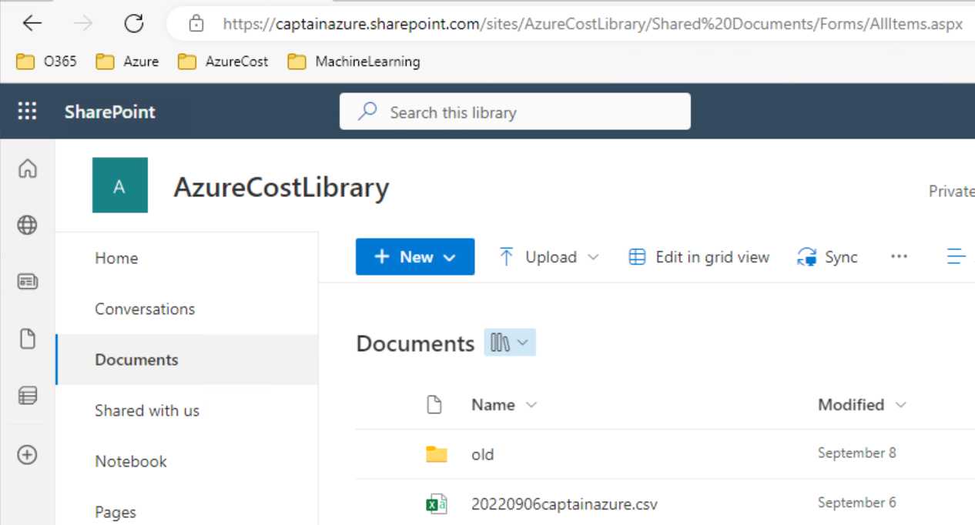
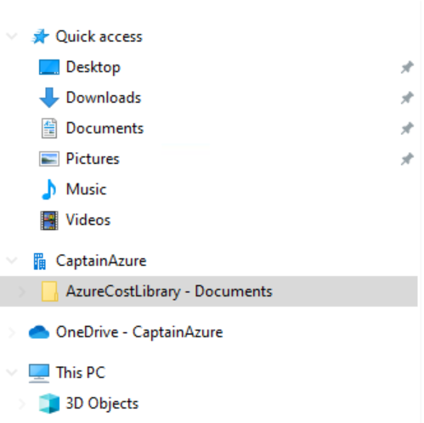
“Sync” will add a shortcut in Explorer

Slide 25
Text layout (without bullet points)
Main topic: Segoe UI, size 28pt
Segoe UI, size 20pt for second level
Segoe UI, size 16pt for third level

Slide 26
Text layout with bulleted text
Main topic: Segoe UI, size 28pt
Segoe UI, size 20pt for second level
Segoe UI, size 16pt for third level

Slide 27
Example with longer headline text wrapping to a second line
When the headline text is 2 lines, move this text block down to align to the lower blue guide
If you don’t see guidelines, click on the View menu, and then check the box in front of “Guides”
Use a “soft return” Shift + Enter to wrap text without adding extra line spacing

Slide 28
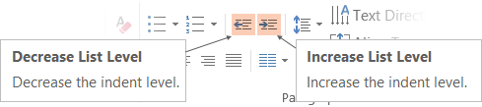
Adjusting list levels
Main topic: Segoe UI, size 28pt
Segoe UI, size 20pt for second level
Segoe UI, size 16pt for third level
Use the “Decrease List Level” and “Increase List Level” tools on the Home menu to change text levels.
Try this:
Place your cursor in the line of text that says “Segoe UI, size 20pt for second level”
Next click the Home tab, and then on the “Decrease List level” tool. Notice how the line moves up one level.
Now try placing your cursor in one of the top “Main topic…” line of text. Click the “Increase List Level” tool and see how the text is pushed in one level.
Use these 2 tools to adjust your text levels as you work

Slide 29
Bullet points layout with subtitle Set the subtitle to 20pt in the same text block, with character spacing Normal
Move the text block down vertically to align to lower guide
If you don’t see guidelines, click on the View menu, and then check the box in front of “Guides”
Hyperlink style: www.microsoft.com

Slide 30
Title square photo layout
Smaller text

Slide 31
Square photo layout

Slide 32
Side-by-side photo layout
Text placeholder
Text placeholder

Slide 33
Three photos layout
Text placeholder
Text placeholder
Text placeholder

Slide 34
Four photos layout
Text placeholder
Text placeholder
Text placeholder
Text placeholder

Slide 35
Top photo with Title

Slide 36
Full bleed photo with Title

Slide 37
Slide palette info
The PowerPoint palette for this template has been built for you and is shown below.
Avoid using too many colors in your presentation.
PowerPoint Theme Accent colors
Accent 1
Accent 2
Accent 3
Accent 4
Accent 5
Accent 6
Use Accent 1 as the main accent color.
Use Accent 2 and Accent 3 only when additional colors are needed.
Use Accents 4-6 sparingly

Slide 38
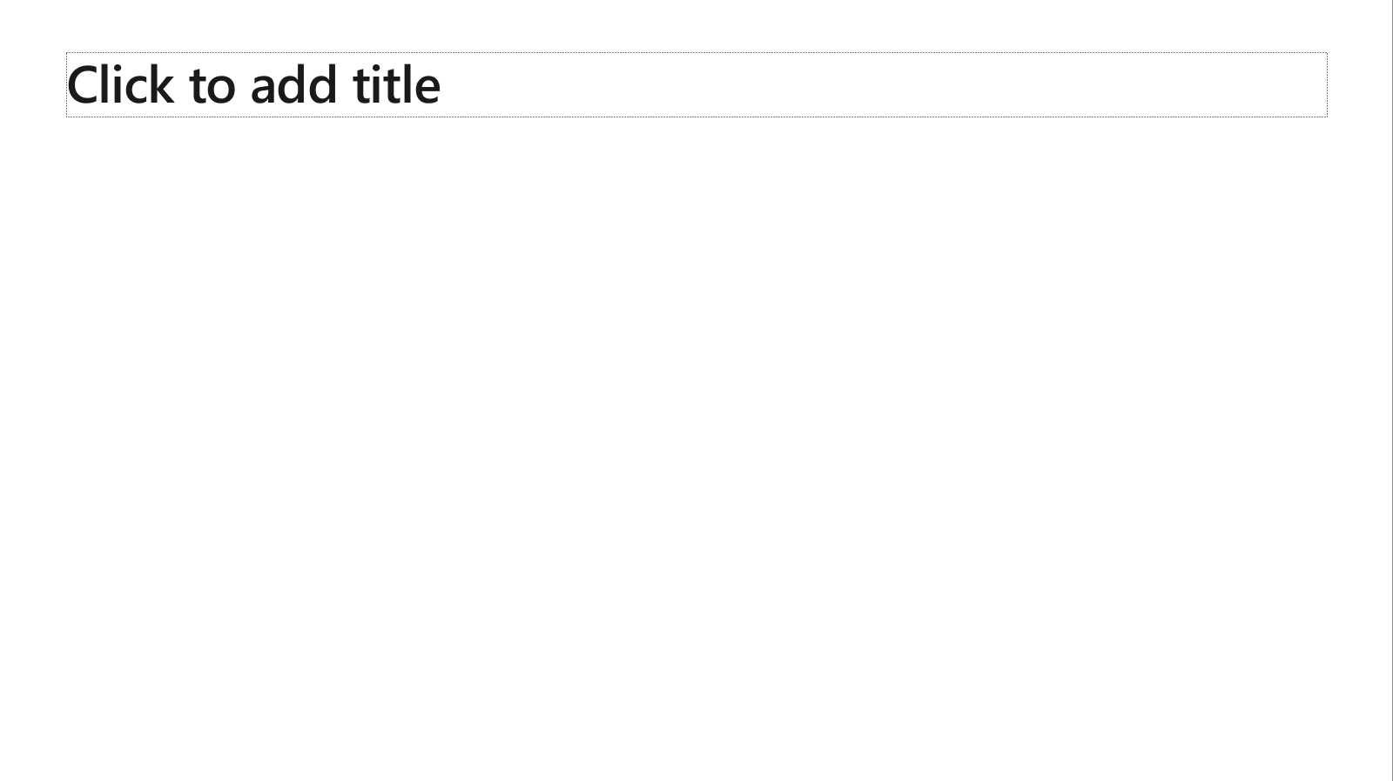
Ensure slide content is accessible
Take the following steps to create accessible content that everyone can consume effectively.
Contrast
Use high contrast colors for maximum readability
The recommended contrast ratio is at least 4.5:1
Shape and color
Use different shapes with a legend to indicate statuses to accommodate for color blindness
Example:
Alt text
Alt text helps people with screen readers understand the content of slides
You should create alternative text for shapes, pictures, charts, tables, SmartArt graphics, or other objects
Here’s how:
Right click on item
Select Edit Alt Text
Enter a Description
If an object is meant to add visual styling and doesn’t contain meaning (e.g. stylistic borders), do not add alt text and instead check Mark as decorative
Slide layouts
Using a built-in slide layout that matches your content ensures a hierarchical reading order of text blocks
Example:
If a new slide will have a title, rather than starting with a blank layout and adding a text block for the title, choose one of the built-in layouts with a title placeholder
Reading order
Screen readers describe content on the screen in the order it was created
To ensure your content is read back in the order you prefer, arrange your objects in the Selection Pane appropriately. Objects on the bottom of the selection pane are read first
Here’s how:
Click the Home tab
In the Drawing group, select the Arrange drop-down menu
Click Selection Pane…
Subject 1
Subject 2
Subject 3
Color Contrast Analyzer
Download this tool to determine the legibility of text and the contrast of visual elements
Download
C1
C2
C3
Additional tips
Be sure to run the Accessibility Checker! Go to File click the Check for Issues drop down menu click Check Accessibility
Videos need to be accessible: If your presentation includes a video, ensure it is captioned and audio described (if appropriate)
Visit the Office Accessibility Center to learn more about accessibility in PowerPoint

Slide 39
Brand and accent colors accessibility
Type and background combinations must meet a minimum 4.5:1 contrast ratio to help ensure people of all abilities can access and understand our communications.
Pick colors carefully and avoid relying on color alone to convey information. Always provide text or other graphical cues to guide customers to our message.
Examples demonstrate correct color use for on-screen applications.
Get the Color Contrast Analyzer
Get more information on accessibility
Get the Microsoft color guidelines PDF
Dark Orange
Rich Black
R255 G147 B73 Hex #FF9349
Dark Yellow
Rich Black
R254 G240 B0 Hex #FEF000
Dark Green
Rich Black
R155 G240 B11 Hex #9BF00B
Dark Teal
Rich Black
R48 G229 B208 Hex #30E5D0
Dark Blue
Rich Black
R80 G230 B255 Hex #50E6FF
Dark Purple
Rich Black
R213 G157 B255 Hex #D59DFF
White
Rich Black
R216 G59 B1
Hex #D83B01
Rich Black
R255 G185 B0
Hex #FFB900
White
R16 G124 B16
Hex #107C10
White
Rich Black
R0 G133 B117
Hex #008575
White
Rich Black
R0 G120 B212
Hex #0078D4
White
Rich Black
R134 G97 B197
Hex #8661C5
Light Orange
White
R107 G41 B41 Hex #6B2929
Light Yellow
White
R106 G75 B22 Hex #6A4B16
Light Green White
R5 G75 B22 Hex #054B16
Light Teal
White
R39 G75 B71 Hex #274B47
Light Blue
White
R36 G58 B94 Hex #243A5E
Light Purple
White
R59 G46 B88 Hex #3B2E58
White
R255 G255 B255
Hex #FFFFFF
Orange
Dark Orange
Dark Yellow
Green
Dark Green
Teal
Dark Teal
Blue
Dark Blue
Purple
Dark Purple
Rich Black
R0 G0 B0
Hex #000000
White
Light Orange
Orange
White
Light Yellow
Yellow
White
Light Green
White
Light Teal
Teal
White
Light Blue
Blue
White
Light Purple
Purple
Extra Light Gray
R242 G242 B242
Hex #F2F2F2
Light Gray
R230 G230 B230
Hex #E6E6E6
Gray
R210 G210 B210
Hex #D2D2D2
Mid Gray
R115 G115 B115
Hex #737373
Dark Gray
R80 G80 B80
Hex #505050
Extra Dark Gray
R47 G47 B47
Hex #2F2F2F

Slide 40





PowerPoint Design Ideas
Get suggestions for slides
PowerPoint Designer can create suggestions for your slide content.
To access Design Ideas, click the “Design” tab in the Ribbon and then “Design Ideas” on the right.
Designer will also trigger when you insert an image.

Slide 41

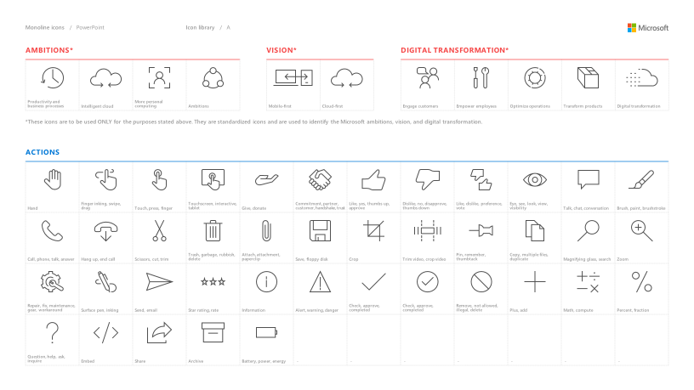
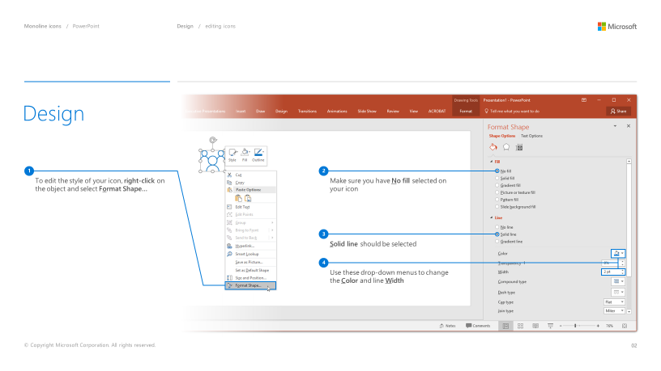
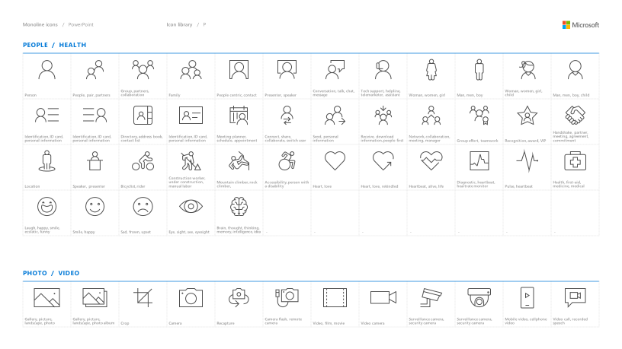
Microsoft monoline icons
Looking for icon resources?
The Monoline icon library for PowerPoint is a slide deck that provides a library of icons for use in PowerPoint presentations.
The Monoline icon style guide for PowerPoint is a pdf with additional guidelines.
Download both from Brand Central.

Slide 42
Demo
Speaker name

Slide 43
Section title

Slide 44
Software code slide
This slide layout uses Consolas, a monotype font which is ideal for showing software code.

Slide 45
Notes (hidden)
Some speakers at Microsoft like to use this slide for hidden “notes slides”.
Delete it if you don’t want to use it.
NEXT: <next slide title>

